Slide 1
2021 Legislative Priorities
National – U.S. Congress & Senate
HR 1 – “For the People Act” – has passed Congress (https://www.govtrack.us)
HR 5 – “Equality Act” – Violates American’s constitutional freedoms & weaponizes civil rights law to punish those who do not hold “correct beliefs”…gender identity/boys in girl’s sports, gender transitions…
Senate Filibuster Rule – Senators to Contact (Joe Manchin D-WV, Kyrsten Sinema D-AZ, Mitt Romney R-UT, Susan Collins R-ME, Lisa Murkowski R-AK)

Slide 2
KEY LINKS
Texas Legislature Online – https://capitol.Texas.gov
Bills
Members
Republican Party of Texas (RPT) – https://www.texasgop.org
Legislative Priorities – https://fliphtml5.com/qiou/txsk
Dallas County Republican Party (DCRP) – https://www.dallasgop.org
Dallasdecides2021.com

Slide 3
Legislative Priorities
Election Integrity – Government & Foreign Affairs
Religious Freedom – State Affairs
Children & Gender Identity – Health & Human Services
Abolish Abortion – State Affairs
Constitutional Carry - Constitutional
Monument Protection – State Affairs
School Choice - Education
Ban Taxpayer Funded Lobbying – Government & Foreign Affairs
Executive Overreach - Constitutional
https://www.texasgop.org/txlege/

Slide 4
Election Integrity
Require citizenship verification of each voter, and felony penalties for Election Code violations that threaten election integrity.
Committee Approved Bills
SB155 Perry – Use of excused Jury lists to clean Voter Registration roles
HB329 Cain – Steps to clear voter roles of noncitizens
HB335 Cain – Cancel Voter Registration if noncitizen
HB574 Greg Bonnen – Prevent Fraud in Election
HB1368 Leach – Election Fraud, Increase penalty
LP Chair – Tanya Robertson tanya@tanya4tx.com

Slide 5
Religious Freedom
Guarantee the rights of individuals, organizations and businesses, to exercise their sincerely held religious beliefs by prohibiting local ordinances, state laws, or executive orders that violate those rights.
Committee Approved Bills
SB251 Paxton – Prohibit Closure of Churches
HB525 Shaheen – Religious Organizations are Essential
HB1218 Oliverson – Display of National Motto in Schools
HB1239 Sanford – Prohibit suspension of laws protecting Religious Freedom
HB1291 Bell, Keith - Relating to notice of the right to object to participation in an abortion procedure for health care personnel of a hospital or health care facility
HCR1 Stephenson - Supporting prayers, including the use of the word "God," at public gatherings and displays of the Ten Commandments in public educational institutions and other government buildings.
Bills Filed
HB188 Bernal - Prohibit Sexual Orientation Discrimination – Against
HB1424 Oliverson – Conscience Protection for Healthcare workers
HB1458 Swanson – Separation based on biological sex of athletic teams from schools
HB1487 Dean – Religious Organizations are essential
HB1569 Schofield – Regulation by HOA regarding religious displays
HB1579/SB654 White/Gettencourt – Free exercise of religion by inmates
HB1691 Tinderholt – Governor nor county/city official may prohibit religious activity
SB129 Johnson – Reflect Same-Sex marriage – Against
SB373 Perry - requiring public school students to participate in interscholastic athletic activities based on biological sex.
SJR27/HJR72 Hancock/Leach – Prohibit Limiting Religious Service
LP Chair – Abraham George contact@abrahamgeorge.com

Slide 6
Children & Gender Modification
Abolish the following practices for minors: intervention to prevent natural progression of puberty; administration of opposite sex hormones; and performance of any type of gender reassignment surgery.
Committee Approved Bills
HB068 Toth – Puberty blockers & Gender Reassignment is abuse of child
HB1399 Krause – Prohibitions on procedures for gender transitioning, reassignment, or dysphoria
Bills Filed
HB407/HB560/SB97 Hernandez/Israel/Menendez – Counseling against Sexual Orientation is unprofessional – Against
HCR2 Swanson – Pornography is Public Health Crisis
LP Chair – Jill Glover j.glover6@verizon.net

Slide 7
Abolish Abortion
Abolish abortion by ensuring the right to life and equal protection of the laws to all preborn children
Committee Approved Bills
HB1280 Capriglione - Relating to prohibition of abortion; providing a civil penalty; creating a criminal offense. (Companion SB391 – Paxton, Bettencourt, etal.
HB1623 Toth – Personhood rights for born & preborn Human beings
HJR80 Slawson – Clarifying Constitution no right to abortion
SB391 Paxton, Bettencourt, etal. (Companion HB1280)
SJR25 Hall - Proposing a constitutional amendment guaranteeing the right to life of unborn children.
Bills Filed
HB42 Swanson – Insurance can’t require abortions
HB44 Swanson – Penalty for certain abortions
HB69 Toth - Prohibit abortion after 12 weeks
HB92 Swanson – Civil liability for certain abortions
HB1165 Slawson – Heartbeat
HB1173 Noble – Prohibit logistical support by government entity for abortion (Comp.SB650)
HB1620 Ramos – repeal SB22 of 2019 – Against
SB650 Campbell – (Companion to HB1173)
LP Chair – Jon Ker sd22col.ker@gmail.com

Slide 8
Constitutional Carry
Allow Texans who legally own firearms to carry them openly or concealed without a permit, while maintaining the option of a permit for reciprocity purposes.
Committee Approved Bills
HB1238 Biedermann - provisions governing the carrying of a firearm
Bills Filed
HB1094 Oliverson - Relating to authorizing certain persons to carry a handgun without a license.
SB540 Springer, Buckingham – Authorizing person to carry a handgun
SB541 Springer – Can’t enforce Federal firearm law if it conflicts with State law
SJR24 Hall - Proposing a constitutional amendment to prohibit the legislature from requiring a license or permit for the wearing of arms.
LP Chair – Stephen Stanley sd02srecman@gmail.com

Slide 9
Monument Protection
All monuments or markers in our state shall be protected by law from being removed, defaced, destroyed, or otherwise dishonored. In particular, specific protection shall be given to the Alamo Cenotaph which shall not be removed from its current location off the Alamo Battlefield footprint.
Committee Approved Bills
HB446 Allison - 3rd Degree Felony for criminal mischief
HB1079 Perez – Return Battleship Texas to San Jacinto upon refurbishment
Bills Filed
HB1186 Anchia – Remove Monuments around Capital – Against
HB1644 Sherman – Texas Historical Commission rule on application for removal
HCR17 Reynolds – Replace Children of Confederacy plague with Victims of Convict Leasing - Against
LP Chair – David Wylie davidwwylie@gmail.com

Slide 10
School Choice
Empower parents and guardians to choose from public, private, charter, or homeschool options for their children’s education using tax credits or exemptions without government restraint or intrusion.
LP Chair – Mark Dorazio mark@dorazioenterprises.com 210-389-8099

Slide 11
Ban Taxpayer Funded Lobbying
Abolish all forms of taxpayer-funded lobbying.
Bills Filed
HB749 Middleton - Restrict public funds for lobbying activities.
HB1702 Middleton – Lobbying by former members of legislature
SB234 Hall - Restrict public funds for lobbying activities.
LP Chair – Terry Harper gop.terryharper@gmail.com

Slide 12
Executive Overreach
We are a free society. One person should not take away those rights without review or consequences.
Bills Filed
HB899 Middleton – May not revoke License for violating lockdown
HB905 Krause – if restrict or prohibit business operations, governor or municipal chief pay withheld
HJR33 Swanson – Protect individual’s right to earn a living
HJR42 Toth – Limits lockdown to 30 days unless call special session
HJR47 Krause – Limits to 30 days and renewed only if special session
SB251 Paxton/Perry – Prohibit suspension of religious freedom & places of worship
SB525 Buckingham – Emergency rule adopted by state agency
SJR20 Johnson – 2/3 of each chamber may petition for special session
LP Chair – Chris Breaux chris.breaux@1791.com

Slide 13
Other Bills
HB31 Swanson – Abolish Harris County Dept of Education
HB373 Oliverson – Change color or registration sticker
HB1033 Oliverson – Transparency in Prescription Drugs
HB1215 Cecil Bell – Texas Sovereignty Act
HJR93 Schofield – Prohibit Eminent Domain for private business
HJR94 Schofield – Daylight Savings Time year round
HJR7 Toth – Term Limits to 12 years

Slide 14
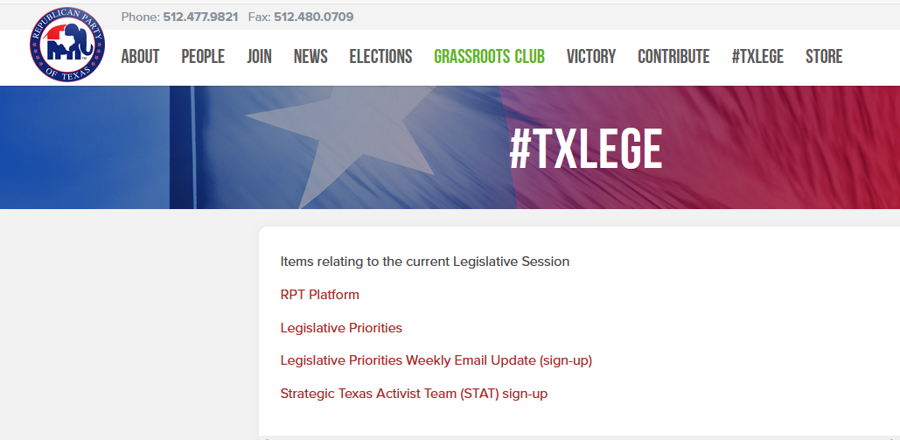
RPT Legislative Priority Updated Information
https://www.texasgop.org/txlege/

Slide 15
Strategic Texas Action Team
This will give you alerts of bills by select Legislative Priority or Platform section

Slide 16
How can I help
https://www.texasgop.org/txlege/
https://capitol.texas.gov/ = TLO
Identify Bills you are in favor of or Support Bills from this presentation
Discuss them with your Representative if HB or HJR
Discuss them with your Senator if SB
Ask your Rep to co-author the bill
Ask your Rep for their issues and let them know yours
Testify in support when committee hearings occur
Work against bills you are against
Discuss them with Legislator
Testify against them when committee hearings occur
2/12 – Senate hearing on Redistricting regarding Harris County
Livestream - https://senate.texas.gov/events.php
Register to testify remotely – by 2/11 9am https://bit.ly/3sONTby

